Slide 1

Sandip institute of technology and research center,Nashik Department of computer science and engineering
A Complete Python Based-
Mini-Project-
Bunnies and Badgers

Slide 2
Presented By-
Vishal Ashiwal
Swaraj Patil
Sahil Gharte

Slide 3


Outline:
Title of the Project
Project Objectives
Key Point
How we Bulit
Expected Outcome

Slide 4
Title of the Project
Bunnies And Badgers
A simple game called Bunnies and Badgers, where the hero, the bunny, has to defend a castle against an attacking horde of badgers.
We chose Python for this tutorial because it’s a simple language to start out with, and is fun and easy to learn.
Visualised the data like Health , Accuracy etc..

Slide 5
Project objectives:
Below are few objectives that need to be achieved to develop this Mini-Project:
To analyse the problem that happen during a Project development especially a project.
To design a game which is user-friendly ,Interactive and most important functional.
To develop a game which is not only functional but ineractive in terms of animation ,background music , some small effect etc..

Slide 6
Key Point:
PyGame:
PyGame is a Free and Open Source cross-platform library for the development of multimedia applications like video games on Python
It uses the Simple DirectMedia Layer library(SDL) and several other popular libraries to abstract most common functions and makes writing these program a more intuitive task.
It can run across many platforms and Os

Slide 7
How we built:
STEP 1:
Import the PyGame library. This allows you to use functions from the library in your program.
Initialize PyGame and set up the display window.
Load the image that you will use for the bunny.
Keep looping over the following indented code.

Slide 8

How we built:
Fill
Fill the screen with black before you draw anything.
Add
Add the bunny image that you loaded to the screen at x=100 and y=100.
Update
Update the screen.
Check
Check for any new events and if there is one, and it is a quit command, exit the program.

Slide 9
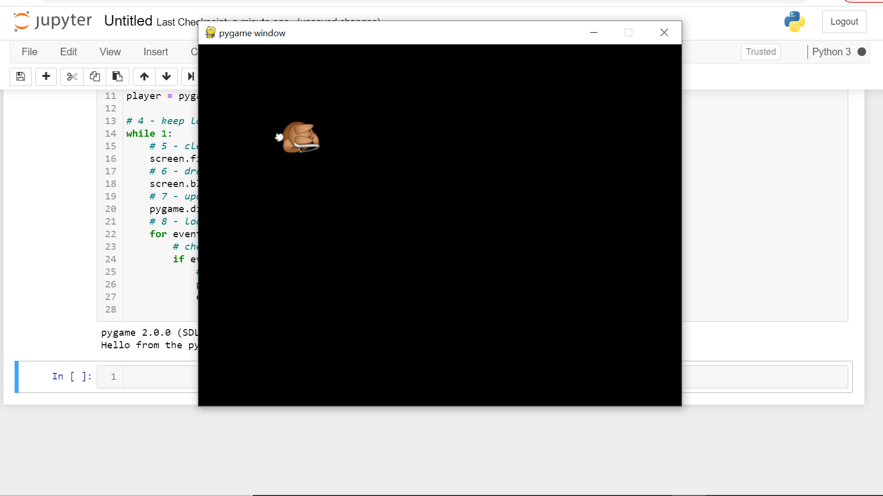
640
480

Slide 10
Step 3:
Adding a background to the game scene. This can be done with a couple more screen.blit() calls.
Blit():The screen object represents your game screen. It is a thin wrapper around a Pygame surface that allows you to easily draw images to the screen (“blit” them). ... blit() accepts either a Surface or a string as its image parameter. If image is a str then the named image will be loaded from the images/ directory.
Adding some actual gameplay elements, like making the bunny , the castle and respond to key presses.

Slide 11
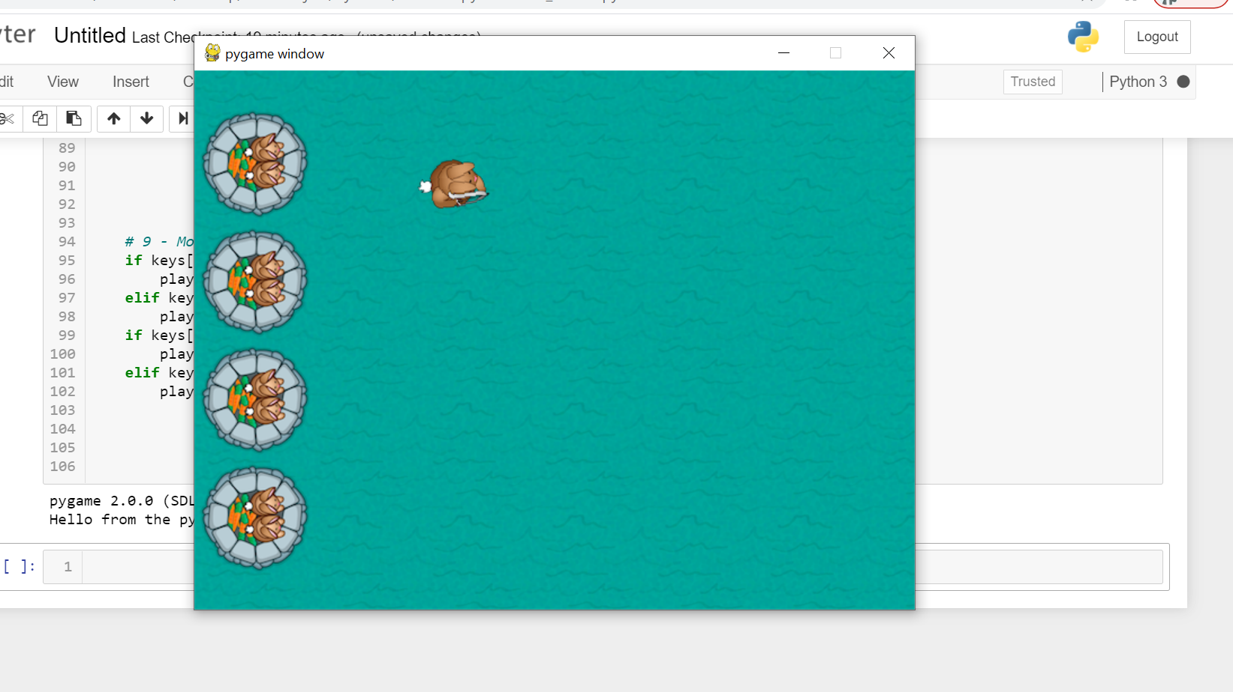
Step 3:
The Bunny
The castle

Slide 12
Step 4: Turning the bunny
Bunny now moves when you press keys but wouldn’t it be even cooler if you could use your mouse to rotate the bunny to face a direction of your choosing, so he’s not facing the same way all the time? It’s simple enough to implement using trigonometry.

Slide 13
Step 4: Turning the bunny
Z – Angle to rotate the character
(5,3)
Z
atan2(diff x, diff y) = z
atan2(5-2 , 3-4) = z
atan2(3 , -1) = z
(2,4)

Slide 14

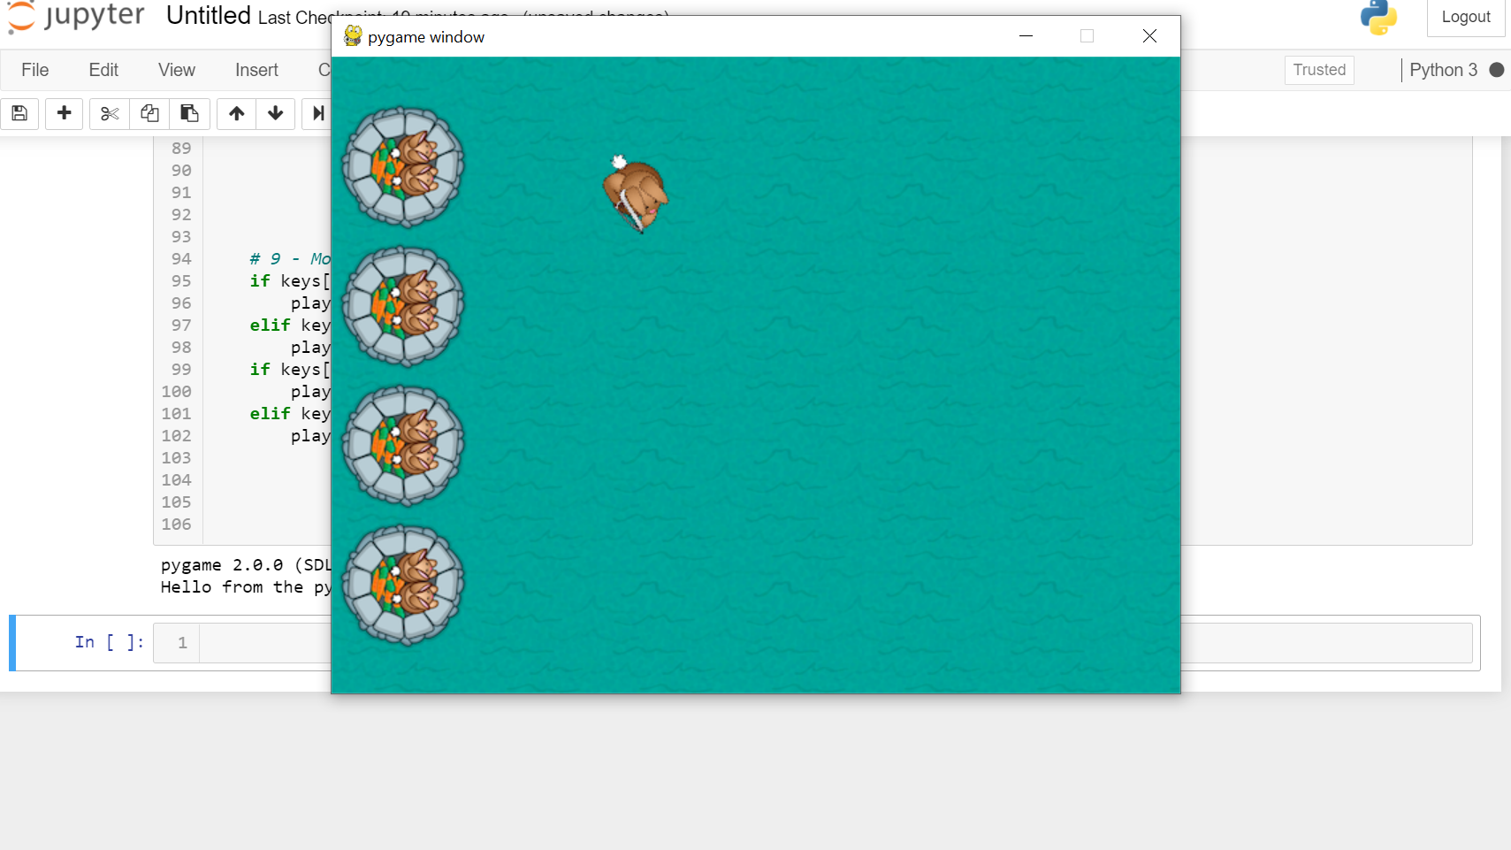
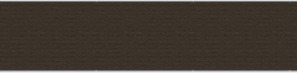
Step 4: Turning the bunny

Slide 15
Step 5 : shoot , bunny. shoot!
Here we add an feature of shooting , and apart from shooting we are also calculating the accuracy of the shoot.
In game, List of the number of shots fired and the number of badgers hit. Later, we will be using this information to calculate an accuracy percentage.
The arrow shoots when the mouse was clicked and if it was, it gets the mouse position and calculates the arrow rotation based on the rotated player position and the cursor position. This rotation value is stored in the arrows array.

Slide 16
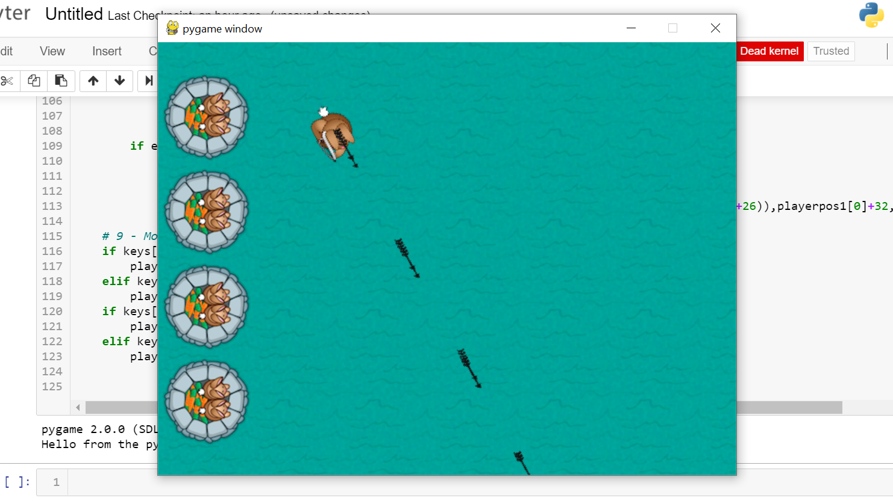
Step 5 : shoot , bunny. shoot!

Slide 17
Step 5 : Take Up Arms! Badgers!
Here we created randomly generated badgers that run at the castle. There will be more and more badgers as the game progresses, also added health value of194 .
Here we set up a timer so that the game adds a new badger after some time has elapsed. We decrease the badtimer every frame until it is zero and then you spawn a new badger.
The badger's x value is less than 64 to the right, then deleted that bad guy and decrease the game health value by a random value between 5 and 20. (Later, displayed the current health value on screen.)

Slide 18
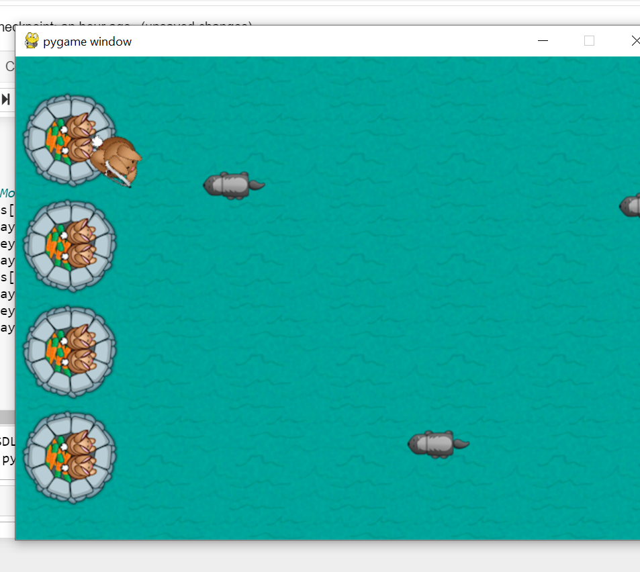
Step 5 : Take Up Arms! Badgers!
If you run the program, you should get a bunch of attacking badgers who vanish when they hit the castle. Although you cannot see it, the badgers are actually lowering your health

Slide 19
Step 7: Collisions with Badgers and Arrows
Time to set the arrows to kill the badgers so we can safeguard your castle and win the game! Basically, we have loop through all of the bad guys and inside each of those loops, we have to loop through all of the arrows and check if they collide. If they do, then delete the badger, delete the arrow, and add one to your accuracy ratio.

Slide 20
Step 8: Add a HUD with Health Meter and Clock
The easiest way is to add a HUD (Heads Up Display) that shows the current health level of the castle. You can also add a clock to show how long the castle has survived.
Added a clock at the Top-Right corner, which represent the game duration.
Added a health bar to represent the data of health in real time and also used to end the game when the health becomes zero or the health bar becomes empty.

Slide 21
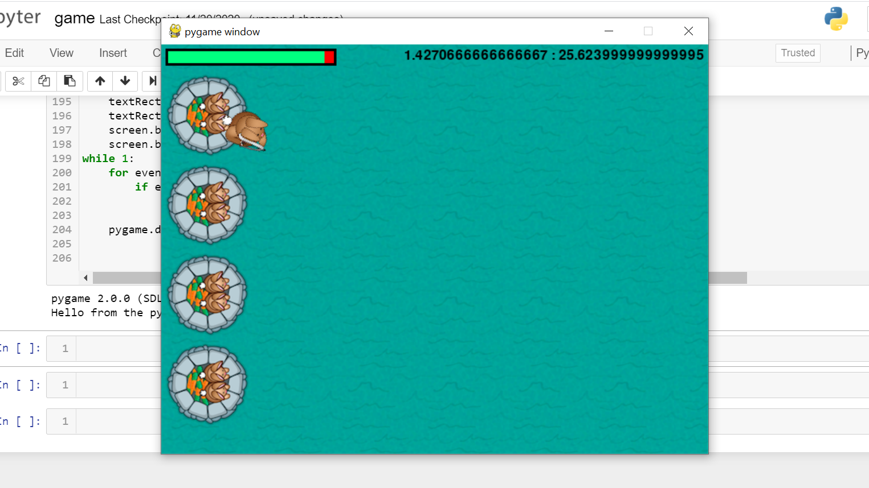
Health Bar
Timer/Clock

Slide 22
Step 9: Win or Lose
Added the win and lose condition as well as the win or lose screen.We done this by exiting out of the main loop and going into a win/lose loop. In the win/lose loop, you have to figure out if the user won or lost and display the screen accordingly.
Here is a basic outline of the win/lose scenarios:
If time is up (90000 ms or 90 seconds) then:
Stop running the game
Set outcome of game to 1 or win
2. If the castle is destroyed then:
Stop running game
Set outcome of game to 1 or win

Slide 23
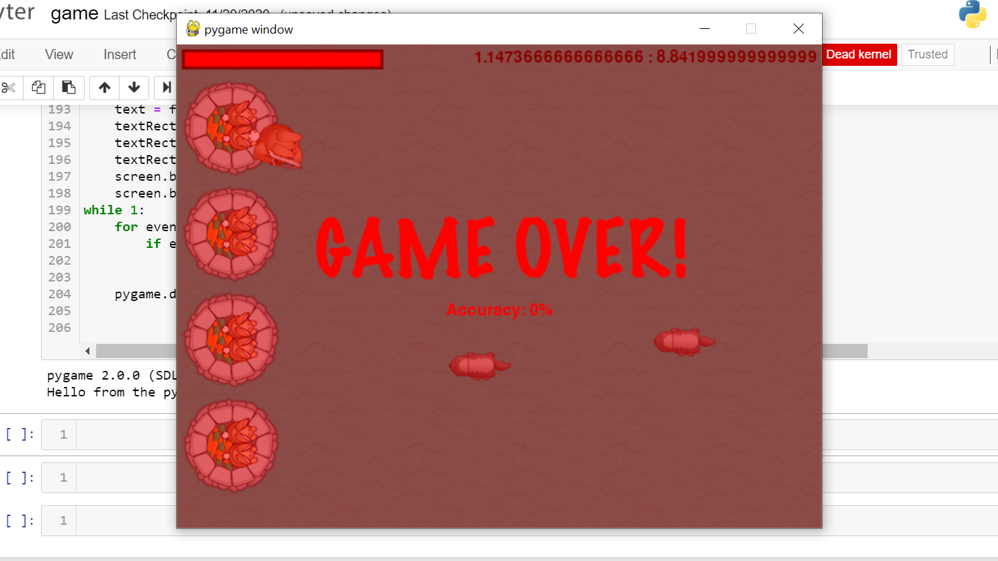
Step 9: Win or Lose

Slide 24
Step 10: Gratuitous Music and Sound Effects!
The game's looking pretty good but how does it sound? It's a bit quiet, isn't it? Adding some sound effects can change the whole feel of a game.
Even here, PyGame makes loading and playing sounds super simple.
Run the game one more time and you'll notice that you now have background music and sound effects for collisions and shooting. The game feels that much more alive! :)

Slide 25
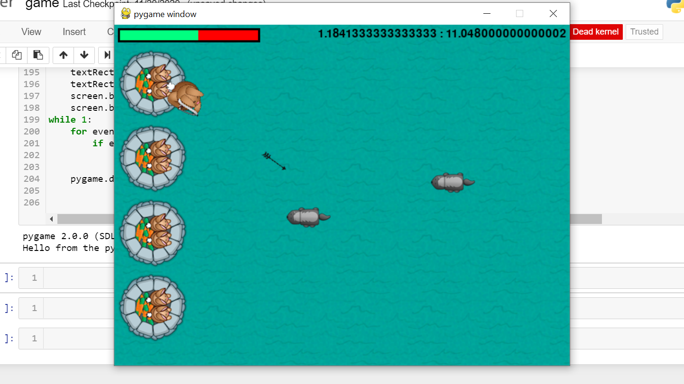
Expected outcome:

Slide 26
Thank you

